Slide 1
Topic: Evaluation and Benchlearning : benchlearning
Prepared by: Aix-Marseille University
Authors : Ariel Mendez, Francesca Petrella, Nadine Richez-Battesti
Date: February 2020

Slide 2
Rationale
Benchlearning : both benchmarking (assessment) and mutual learning
Three central questions :
Why transfer ?
What to transfer ?
How to transfer ?
Main principles
Not a top/down process but a participative one
Benchlearning is a highly contextualised process : need coherence with the cultural, social and institutional context and with regional needs and priorities
Relevance/compatibility/feasibility for the organization

Slide 3
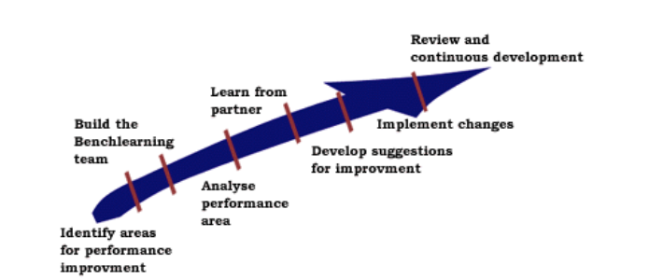
The benchlearning process
source: Frayssinhes (2016)

Slide 4
A proposition of method : 3 steps
Identify
Presentation of the results of the study module: synthesis realised by the partner - 30 minutes
Identify needs and priorities at the regional level: discussion in small working groups (max 8-10 persons). Each group prepares a proposal of priorities - 30 minutes
Analyse and learn
Discussion of the proposals with the large group : what are the regional priorities? how the foreign experiences could be a source of inspiration or even provide some options of responses; what are the opportunities and the risks? – 45 minutes.
Summarise what we have learned: what are our priorities and what are the potential responses or sources of inspiration for our territory? – 15 minutes
Develop suggestions
Discussion within small working groups about what could be experimented in our region during the testing phase. Discussion includes concerns about the implementation and feasibility processes. Each group crafts a proposal – 1 hour
Exchange with the large group of all the suggestions and decide which ones could be explored – 1 hour
Create a small group of volunteers who would like to prepare the experimentation phase.
Cf. One example of method for organising the discussion : a process of consent decision making (see next slide)

Slide 5
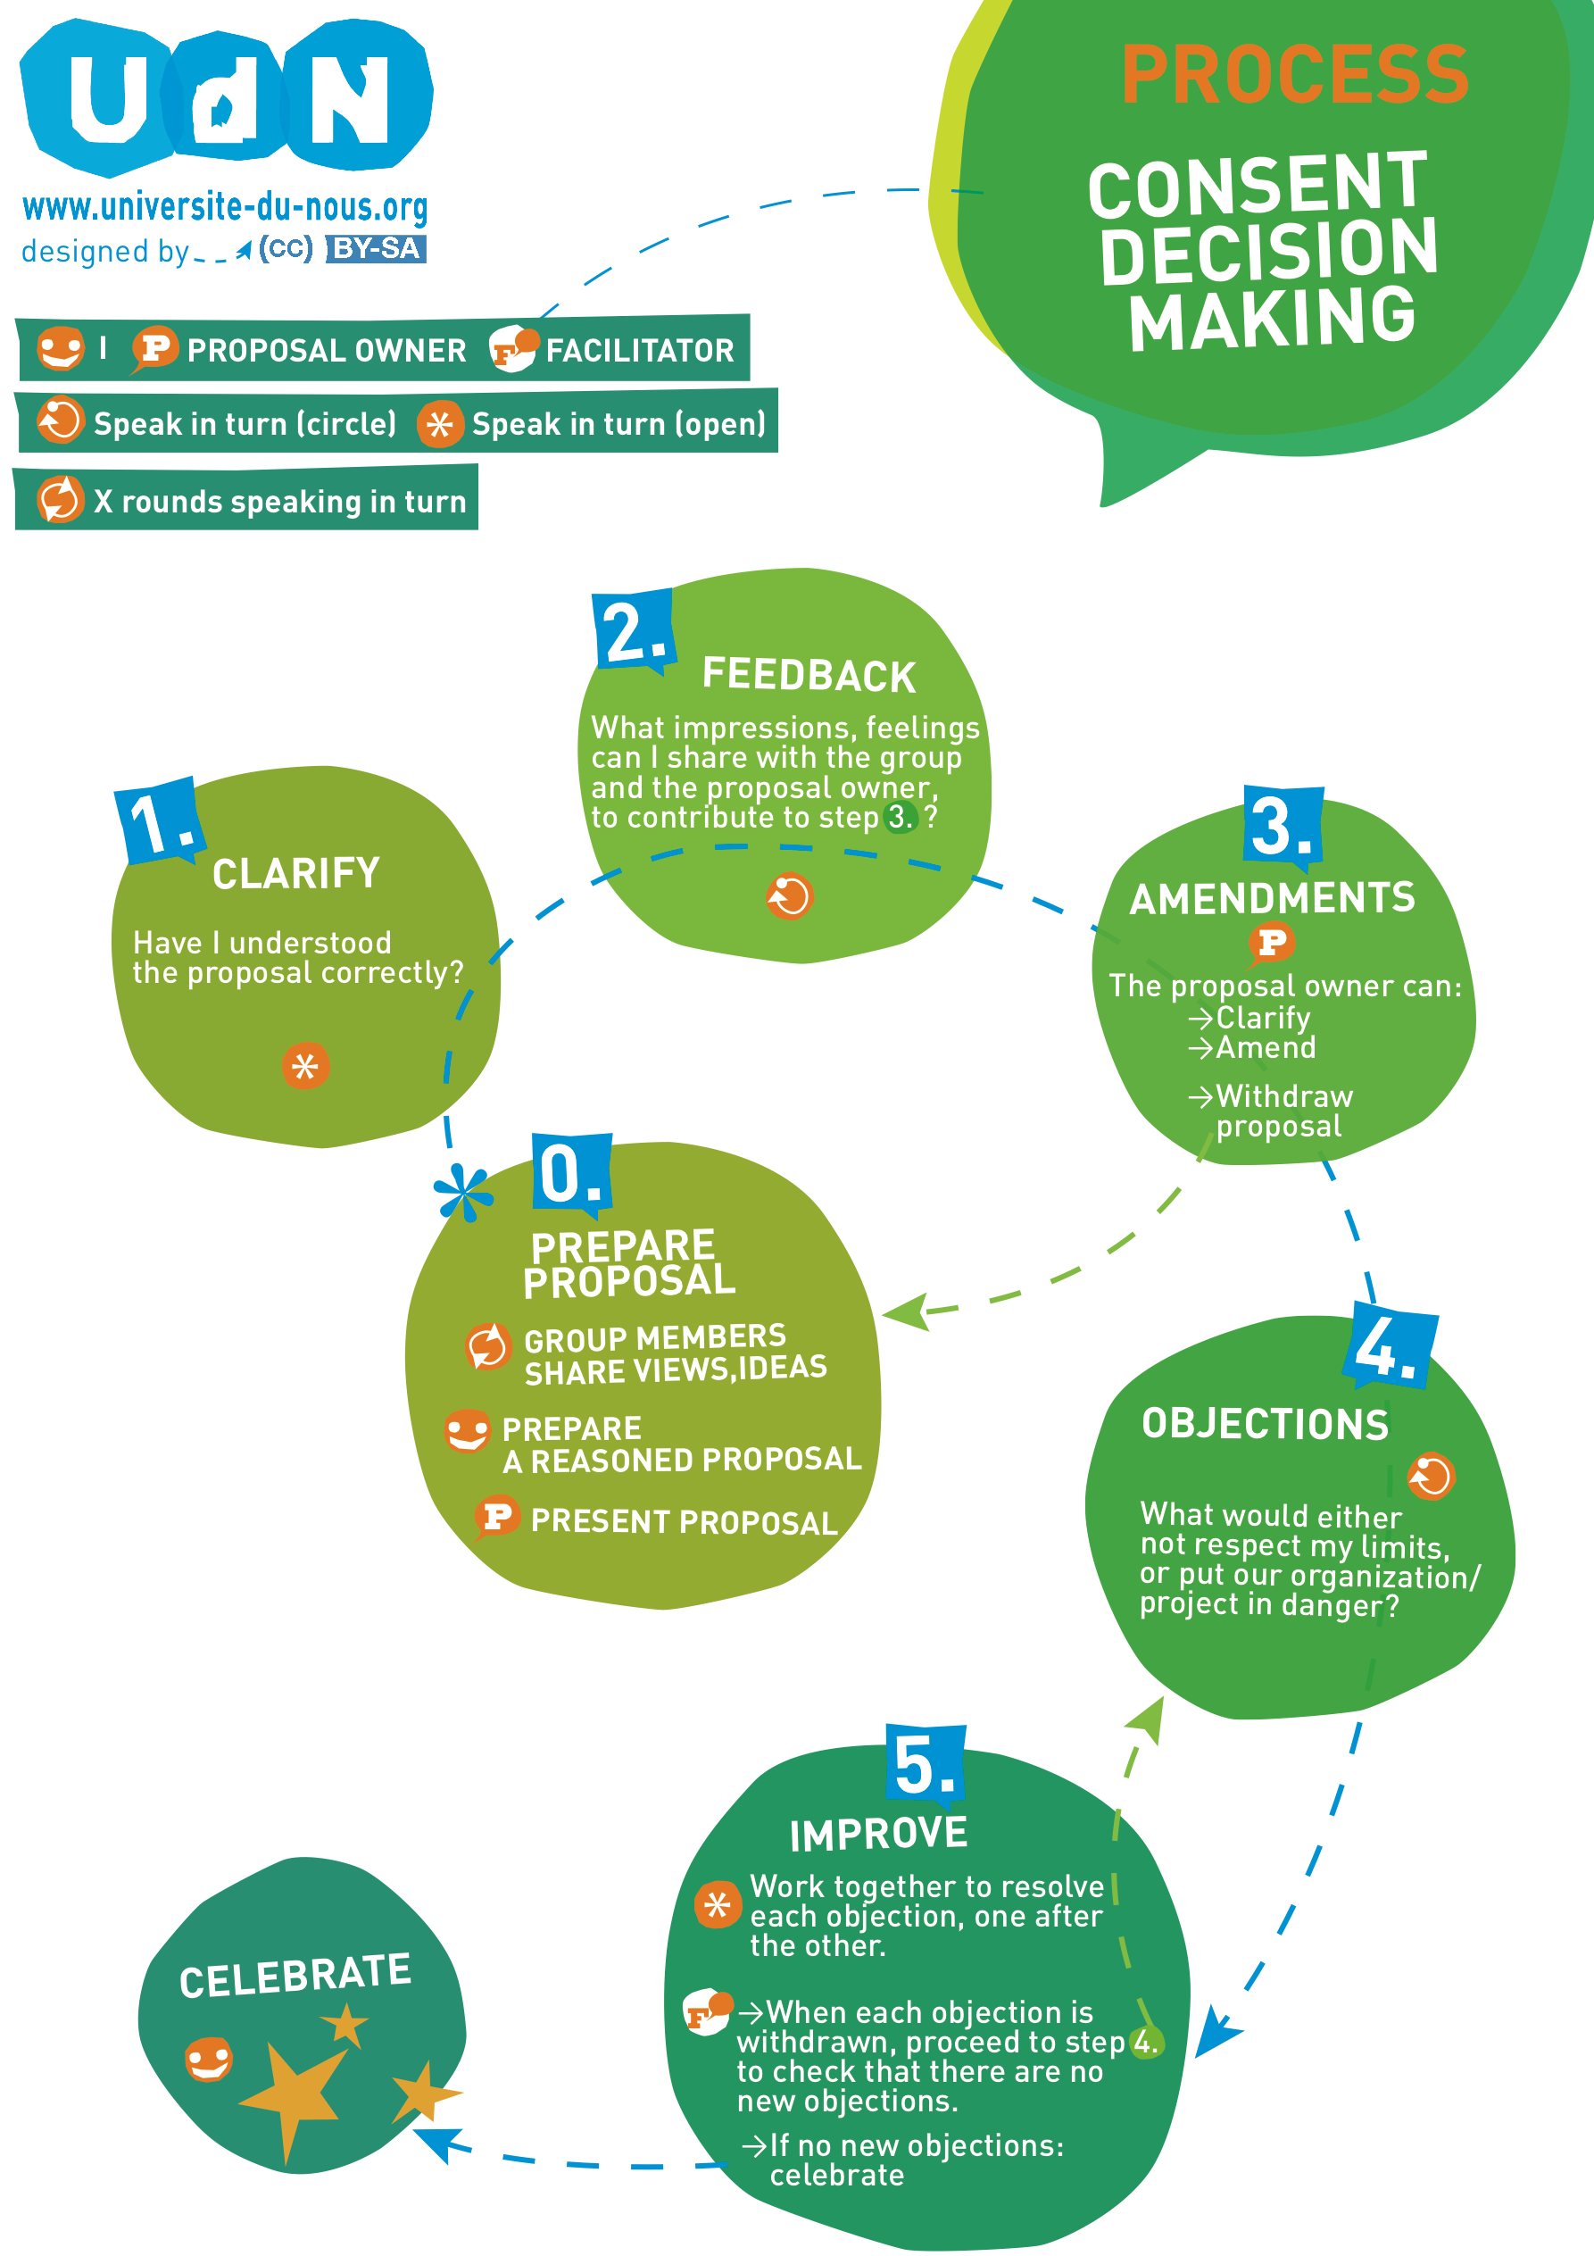

Slide 6
Thank you for your attention

